Slide 1


Stock Allocation

Slide 2
Stock Allocation Overview
Stock Allocation is where we manage sales orders based on stock availability (shortage vs. sufficient stock).
  Tab "Allocated": Shows sales orders that have sufficient stock.
  Tab "Unallocated": Shows sales orders that have sufficient stock.

Slide 3
Editing Sale Order
To edit a sales order, it must be set tounallocatedfirst. Afterwards, the sales order will appear under Option Order Editing.
Steps to edit a sales order:
  Navigate to Stock Allocation.
  Change the sales order status from Allocated → Unallocated.
  Once completed, proceed to Order Editing.

Slide 4
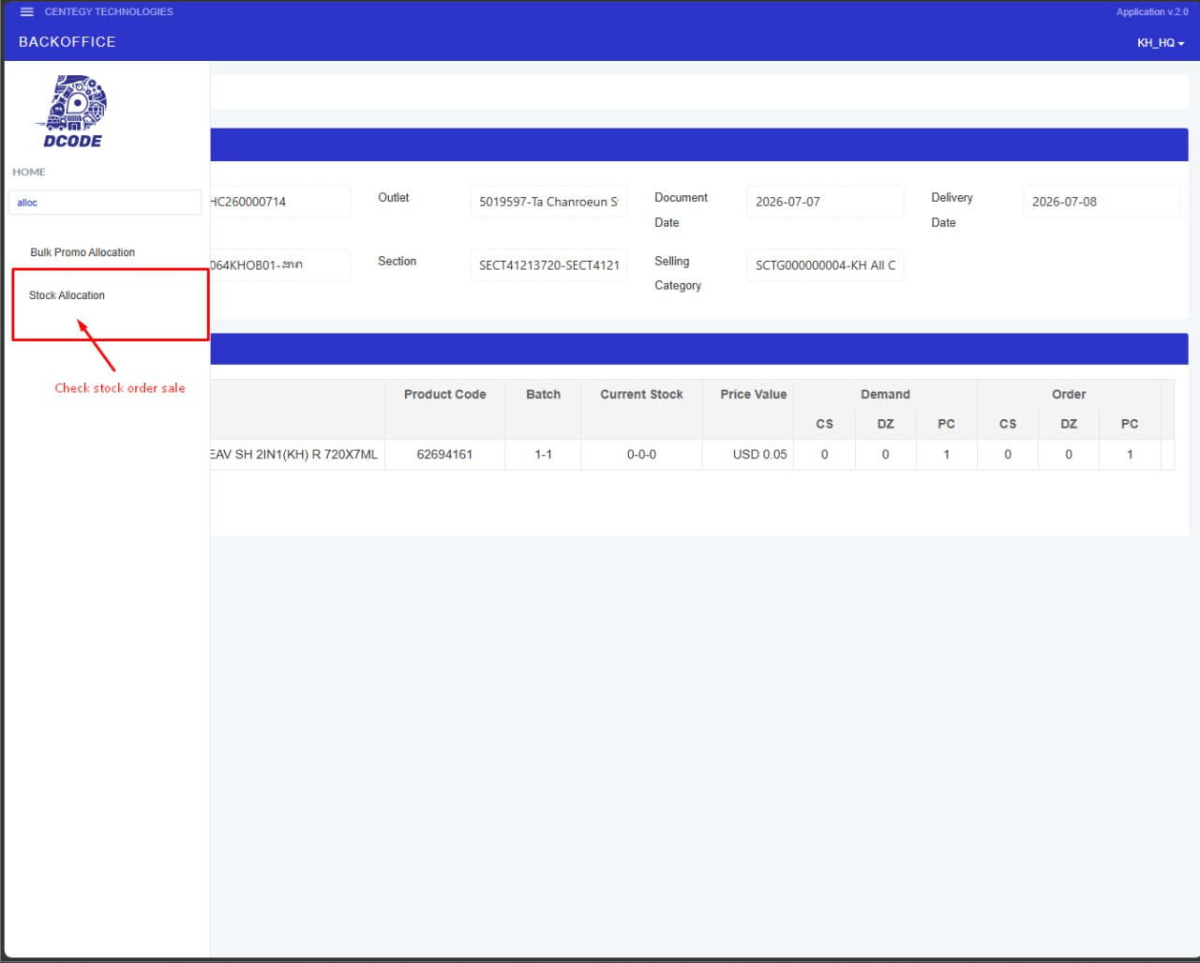

Slide 5
Search "Stock Allocation"
  Click on icon "⚙️"!
  Then, click on the search bar and type "Stock Allocation" to search.
  When the menu is displayed, we click on it.

Slide 6
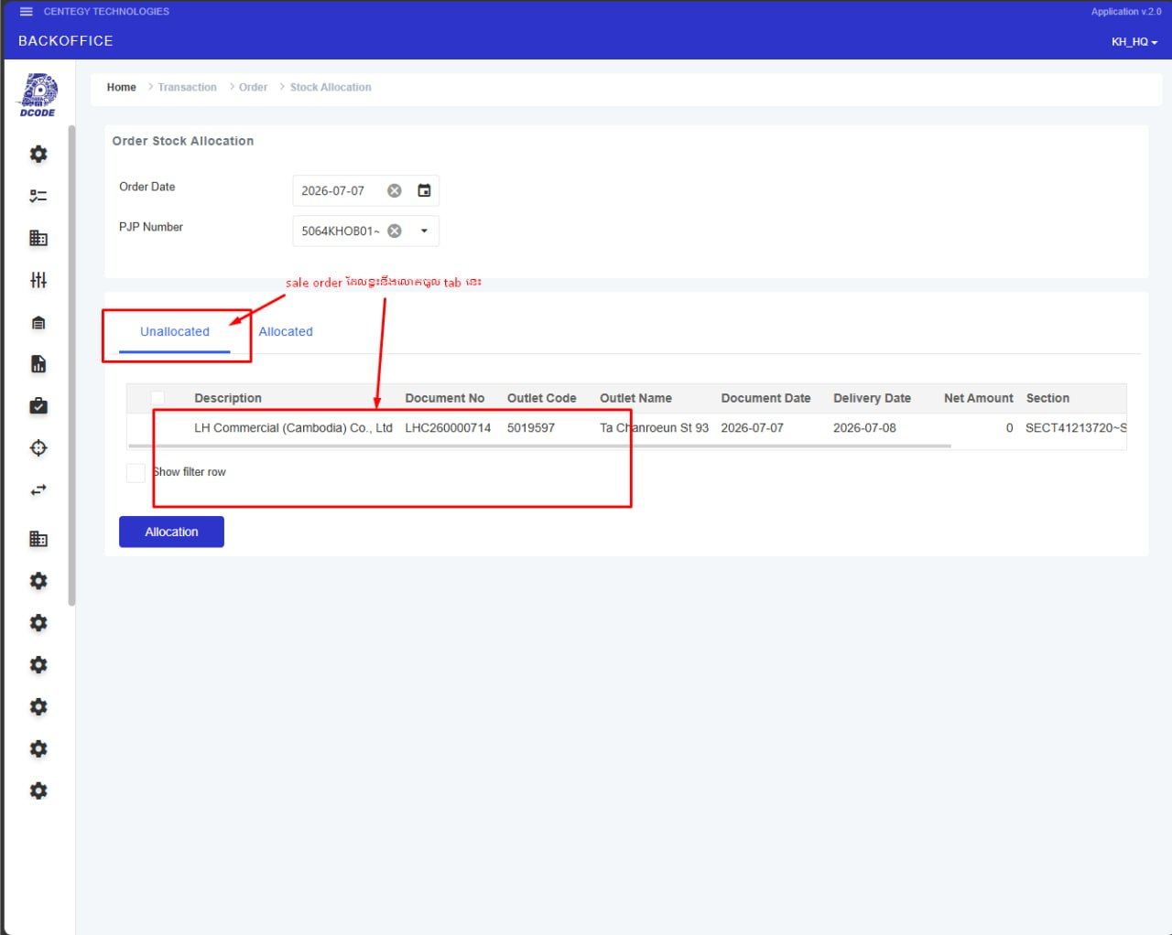

Slide 7
Unallocated Tab
Tab "Unallocated" shows the order which is shortage.
If we want to make it allocated (Unallocated to Allocated), we need to:
  Select one row by clicking on it (it will highlight blue).
  And then click on button "Allocation"

Slide 8
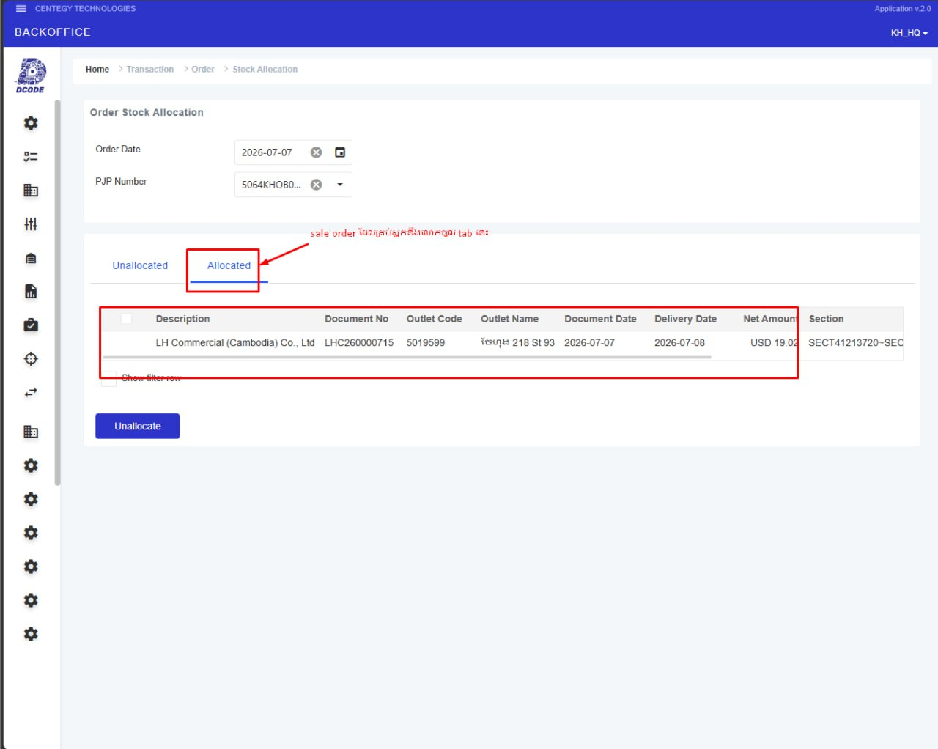

Slide 9
Allocated Tab
Tab "Allocated" shows the order which is enough.
If we want to make it unallocated (Allocated to Unallocated), we need to:
  Select one row by clicking on it (it will highlight blue).
  And then click on button "Unallocation"

Slide 10
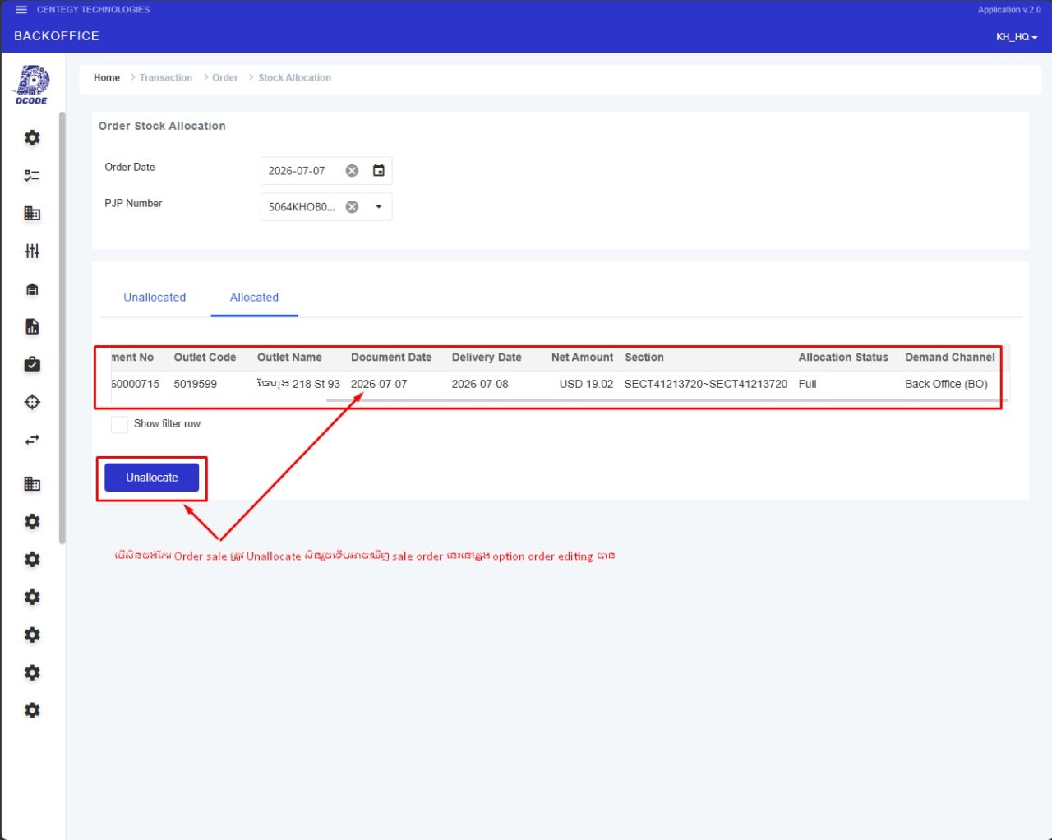

Slide 11
Confirm Order Reserve
  If it is allocated, we see it in a table of tab "Allocated".
  If it is unallocated, we see it in a table of tab "Unallocated".

Slide 12

Thank You!

